Slide 1
Health Information System
Jeff Githinji

Slide 2

Overview
I have designed a short program that simulates a basic health information system for managing clients and health programs/services.

Slide 3
Problems to solve
Manual patient tracking leads to errors
Difficulty searching patient histories
1
3
2
No centralized program enrollment

Slide 4
IMPACT
30% time wasted on admin tasks (WHO, 2023)
Higher risk of missed treatments

Slide 5
Solution Overview

Slide 6
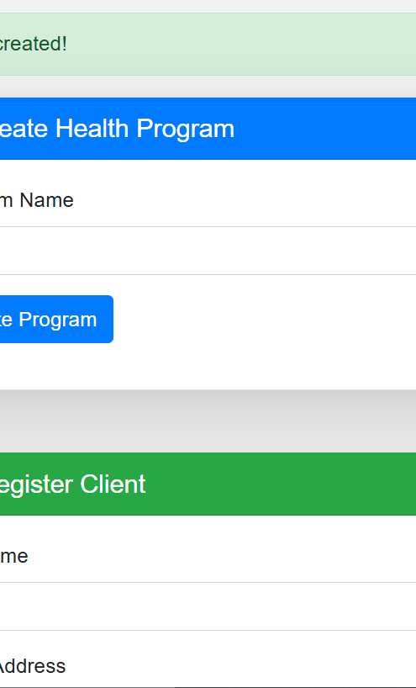

Key Features
- 📝 Digital program management
- 👥 Patient registration in <30 seconds
- 🔍 Instant search across all records
- 🗑️ Safe deletion with confirmations

Slide 7

Technical Highlights
- RESTful API design
- Mobile-responsive UI
- SQLite → Easy deployment
The system reduces patient onboarding time from 5 minutes to under 30 seconds while preventing duplicate records.

Slide 8
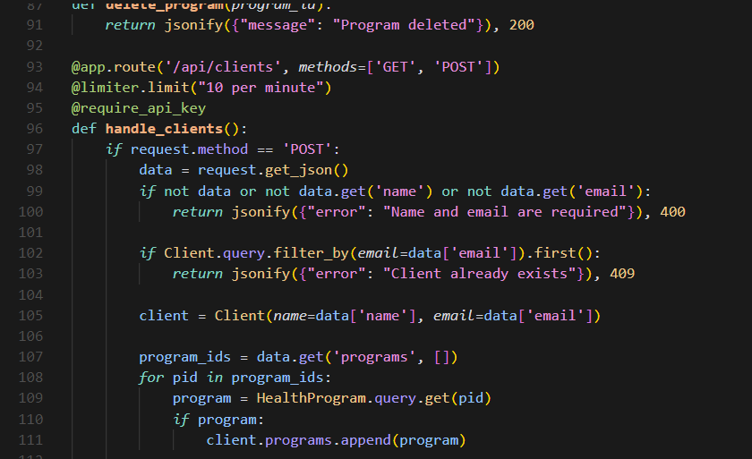
Technical Deep Dive
The backend uses Flask with three key safeguards: API keys, rate limiting, and input validation to prevent abuse.

Slide 9
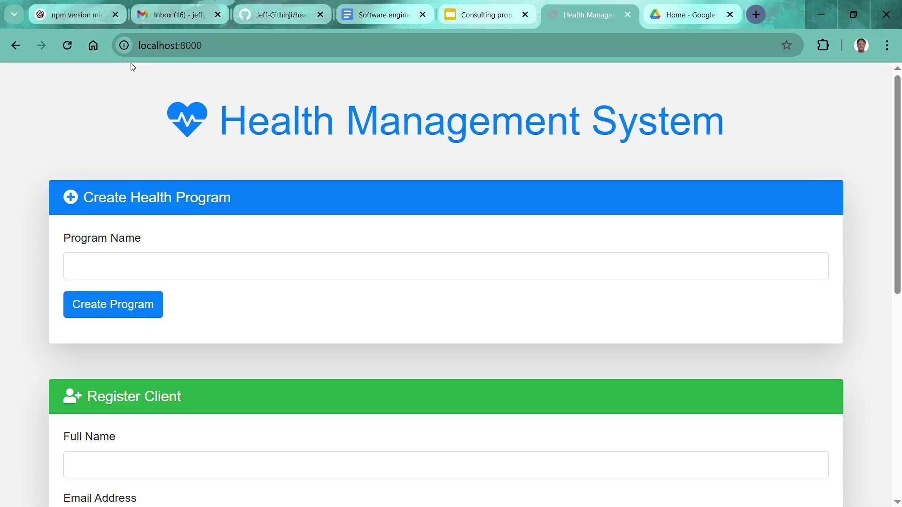
Live Demo

Slide 10
Vision
Phase 1: Now
**Phase 3:**
**Phase 2 (Next):**
- Core patient management
- Mobile app for field workers
20XX
20XX
20XX
20XX
- Treatment progress tracking
- SMS appointment reminders
.

Slide 11
Lessons Learned
**Key Takeaways:**
1. API design is harder than it looks!
2. User confirmation prevents errors
3. Documentation saves debugging time
**New Skills:**
- CORS configuration
- SQLAlchemy ORM
- Vanilla JS state management

Slide 12
Thank you.
I'd love to discuss how this could be deployed in real clinics. Thank you for your time and consideration!

